Slide 1












High speed RSA cryptosystem on CPU
Group 6
LIN Xiaotao (Justin) 1930026081
ZHU Yizhuo (Bruce) 1930004048
LI Sirui (Laurel) 1930026068

Slide 2
Contents
01
02
03
04
05
Introduction
Karatsuba
Montgomery
Multi-threading
Demo
RSA
Virtual Machine
Bitwise Operation
Function Operation
Reduction
Multiplication
Exponentiation
Workflow
Encryption: 0.033s → 0.0031s
Decryption: 2.272s → 0.2119s

Slide 3



01
Introduction
RSA
Virtual Machine

Slide 4

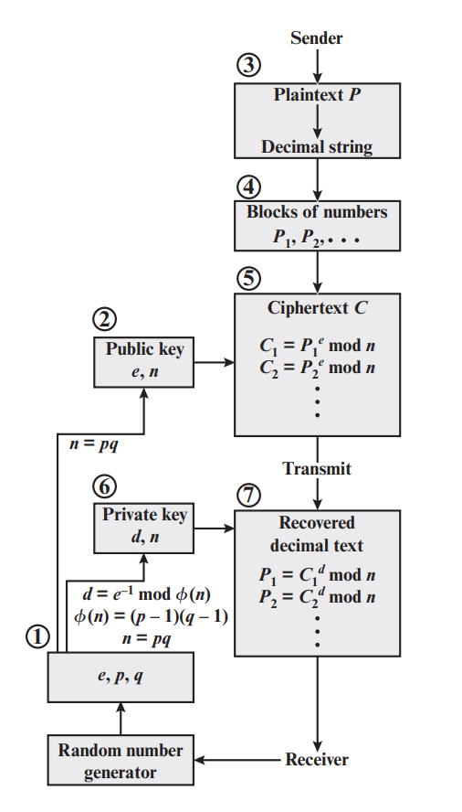
RSA

Slide 5
02
Karatsuba
Bitwise Operation
Function Operation

Slide 6
A
Karatsuba
B
Ah
Al
Bh
Bl
Using address: &a[digits/2]
Ah*Bh
Al*Bl
Ah*Bl+Al*Bh
Overflow may occur
Al*Bl
(Ah+Al)*(Bh+Bl)
Ah*Bh
-
When sign sign(A)*sign(B)=-1: + When sign sign(A)*sign(B)=-1: -
Al*Bl
(Ah-Al)*(Bh-Bl)
Ah*Bh

Slide 7
Karatsuba
Carry
- or + Carry
Al*Bl
Carry +
Ah*Bh
Carry +
When sign sign(A)*sign(B) = -1: + When sign sign(A)*sign(B) = -1: -
(Ah-Al)*(Bh-Bl)
Carry + or -

Slide 8






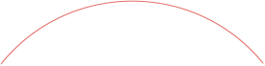


03
Montgomery
Reduction
Multiplication
Exponentiation

Slide 9



Montgomery
Montgomery Reduction
${TR}^{−1}mod m$
Montgomery Multiplication
$xyR^{−1} mod m$
Montgomery Exponentiation
$x^{e}mod m$

Slide 10

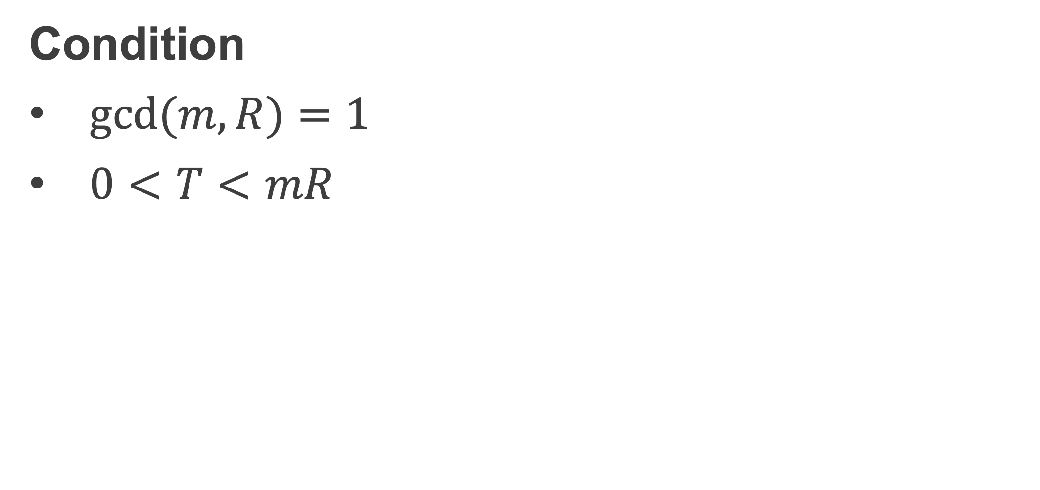
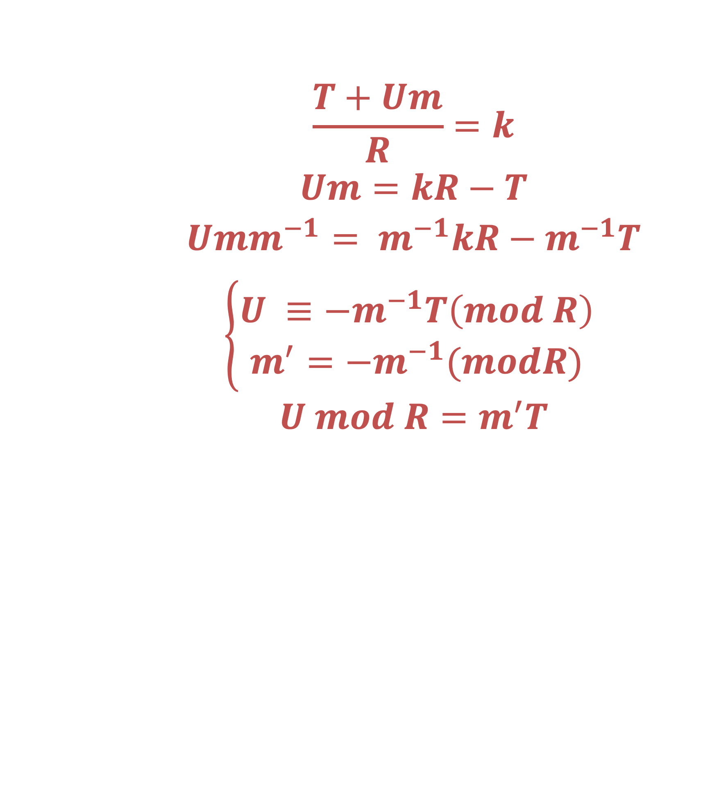

Montgomery Reduction(T, R, N)
$$(T+Um)/R$$
$${TR}^{−1}mod m$$
Condition
$gcd⁡(m,R)=1$
$0<T<mR$
Estimate
By using bit shift instead of division, By getting the low 32 bit instead of traditional modular to
Improve speed performance
$$\frac{T+Um}{R}=k$$
$$Um=kR−T$$
$$Umm^{−1}= m^{−1}kR−m^{−1}T$$
$$\left\{\begin{aligned}U ≡−m^{−1}T\left(mod R\right) \\ m^{′}=−m^{−1}(modR) \end{aligned}\right.$$
$$U mod R=m^{′}T$$
Main Point
Pre-calculation
U
big array division

Slide 11
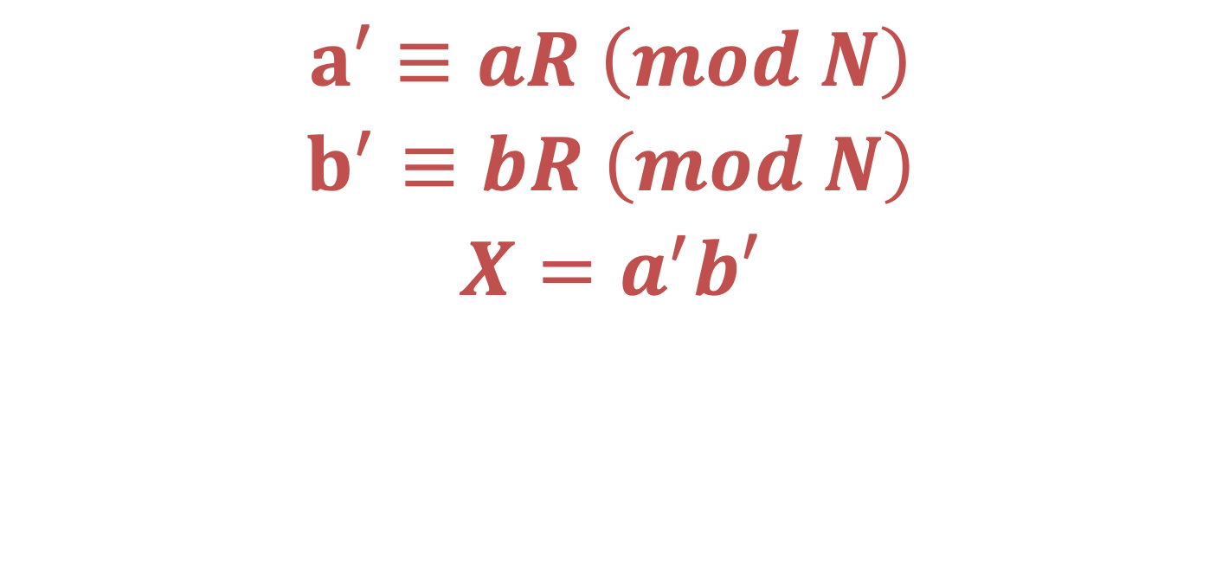

Montgomery Multiplication(a , b, N)
$$a′≡aR \left(mod N\right)$$
$$b^{′}≡bR \left(mod N\right)$$
$$X=a^{′}b′$$
Montgomery Reduction(X, R, N)
$$abR (mod N)$$
Montgomery Reduction(abR, R, N)
$$ab (mod N)$$

Slide 12
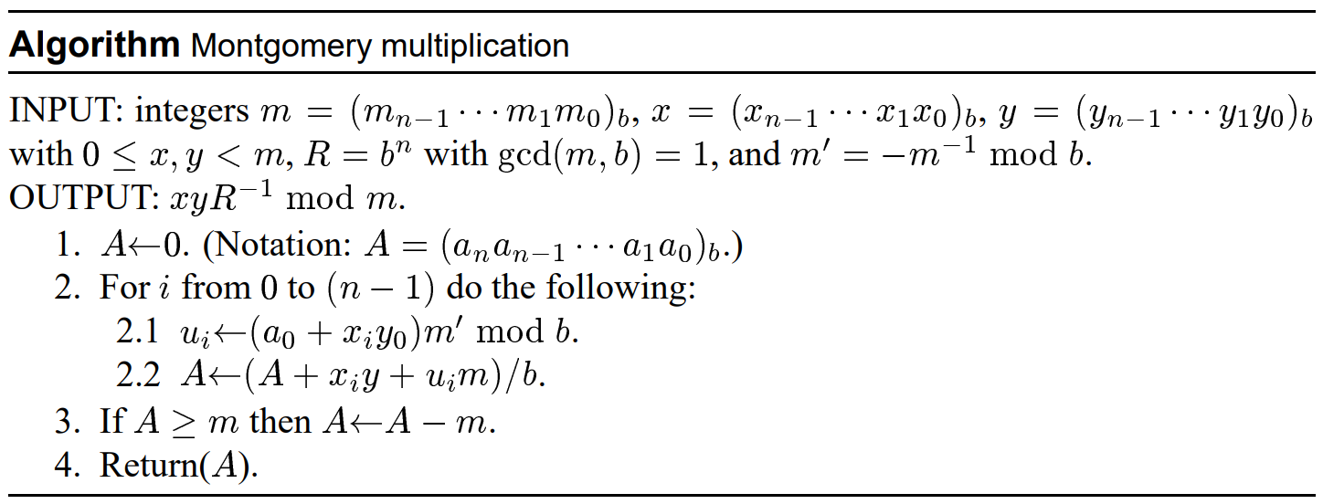
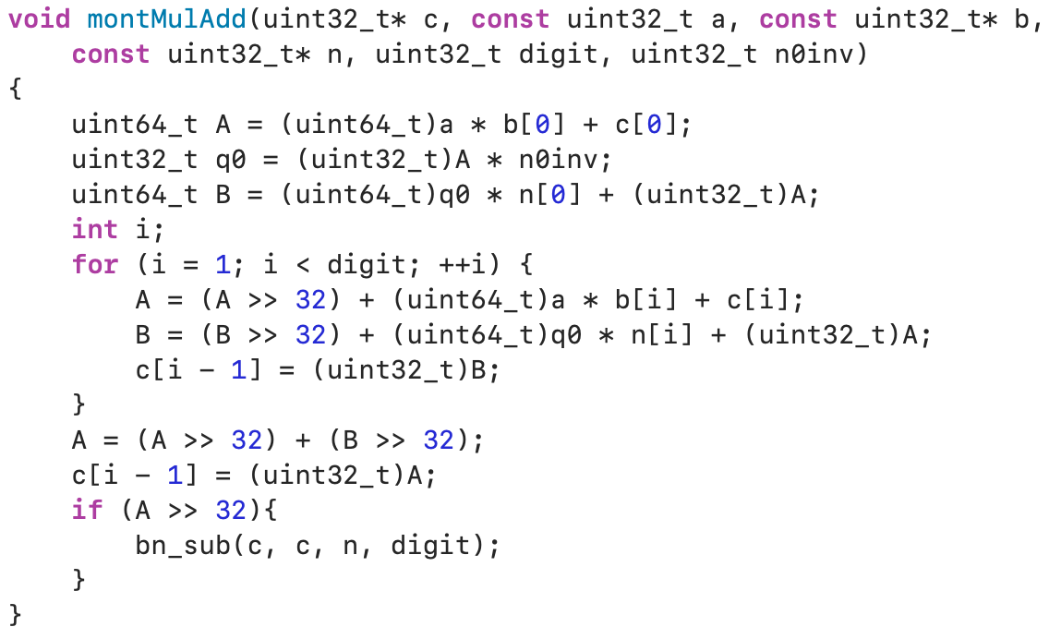
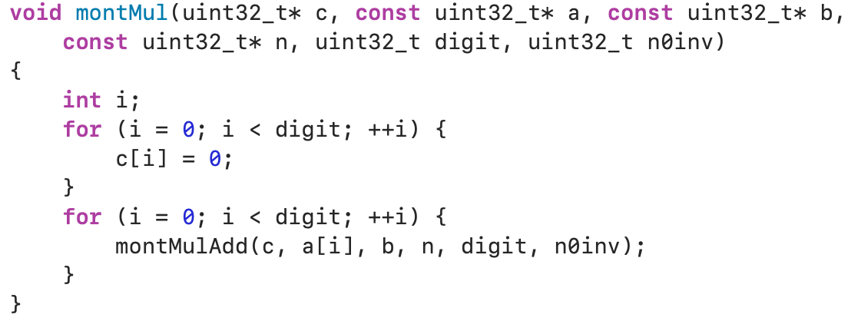
Code and analysis

Slide 13
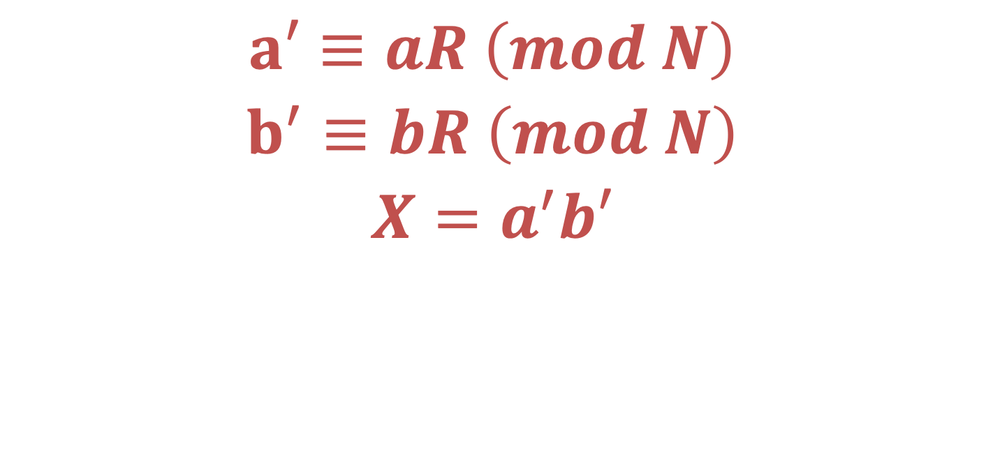

Montgomery Exponentiation(a , b, N)
$$a′≡aR \left(mod N\right)$$
$$b^{′}≡bR \left(mod N\right)$$
$$X=a^{′}b′$$
Montgomery Reduction(X, R, N)
$$abR (mod N)$$
Montgomery Reduction(abR, R, N)
$$ab (mod N)$$

Slide 14
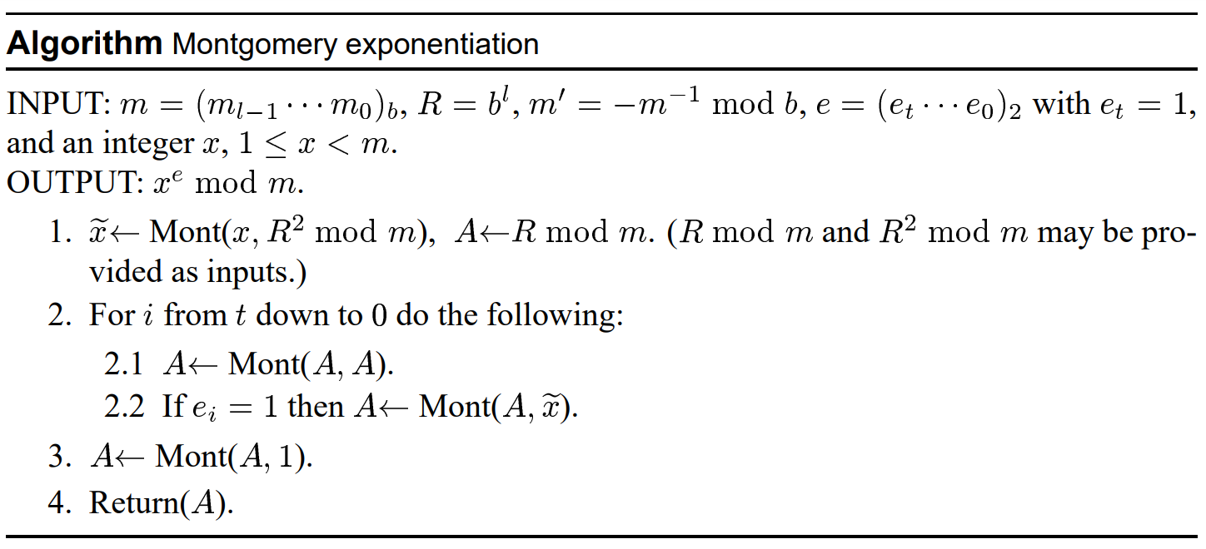
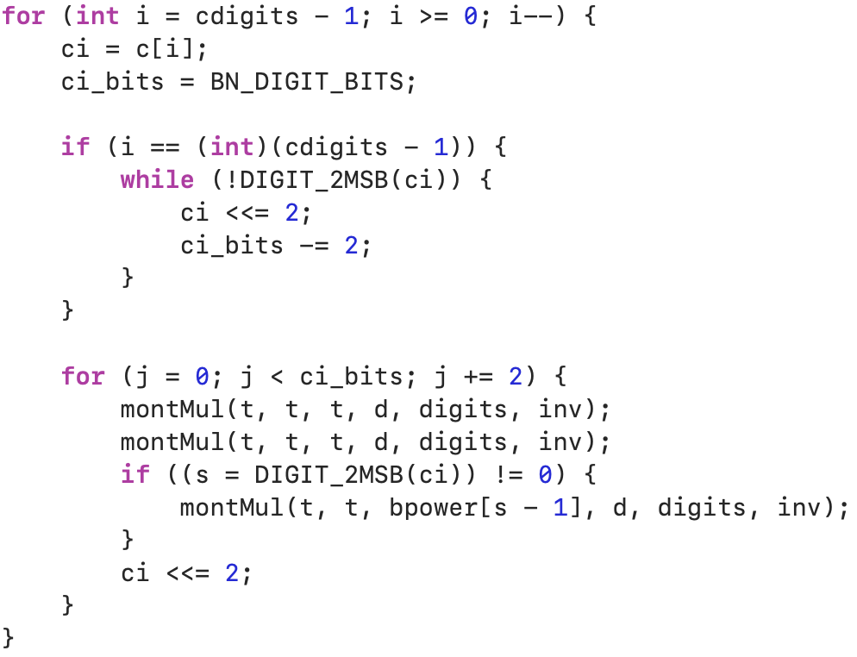
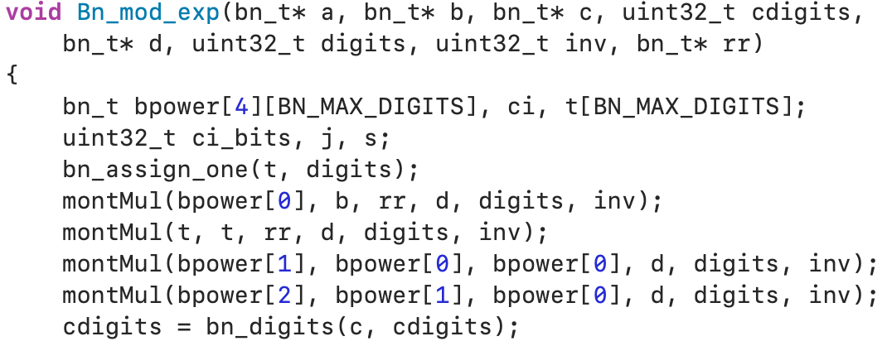
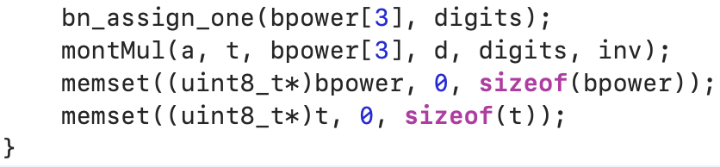
Code and analysis

Slide 15
04
Multi-threading
Workflow

Slide 16
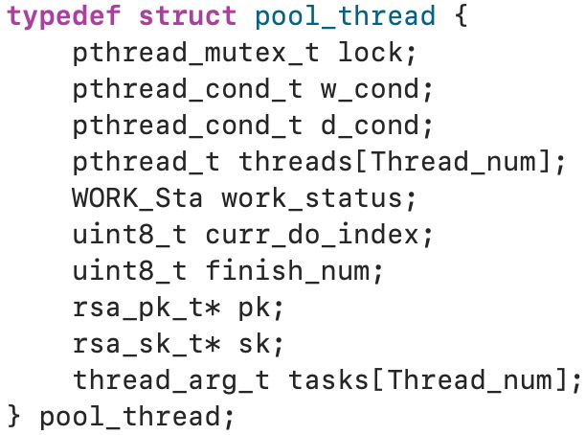
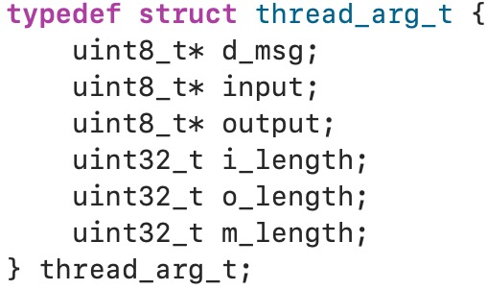
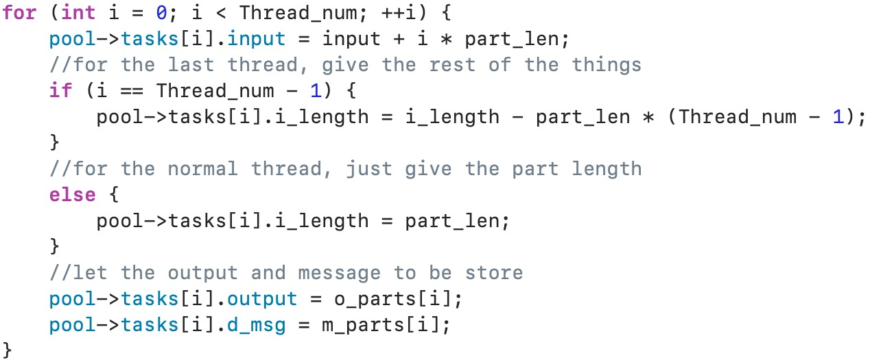
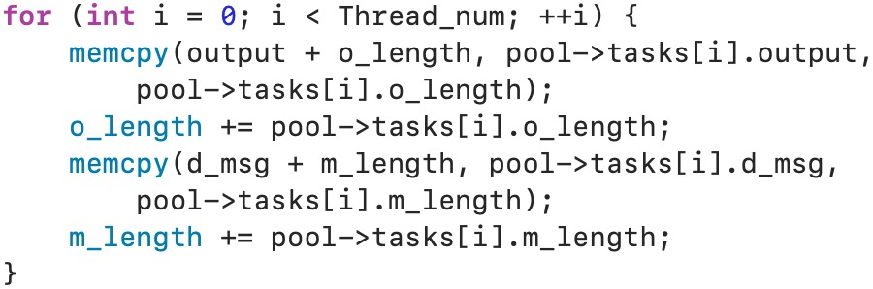
Multi-threading
Manage the thread
Structure define
Attribute for the function
Task distribute
Merge

Slide 17







05
Demo
Encryption: 0.033s → 0.003s
Decryption: 2.272s → 0.211s
Group 6

Slide 18
Thank you!
THANKS FOR YOUR LISTENING
Group 6

